Slide 1


<Name>
<Date>

Slide 2

Outline
Executive Summary
Introduction
Methodology
Results
Conclusion
Appendix

Slide 3
Executive Summary
Summary of methodologies
Summary of all results

Slide 4
Introduction
Project background and context
In this capstone, we will predict if the Falcon 9 first stage will land successfully. SpaceX advertises Falcon 9 rocket launches on its website, with a cost of 62 million dollars; other providers cost upward of 165 million dollars each, much of the savings is because SpaceX can reuse the first stage. Therefore if we can determine if the first stage will land, we can determine the cost of a launch. This information can be used if an alternate company wants to bid against SpaceX for a rocket launch.
We want to find what characteristic affect success rate of landing. Is it geographical feature or maybe payload mass or something else. We want to explore connection between different features and if possible develop predictive model.

Slide 5

Section 1

Slide 6
Methodology
Executive Summary
Data collection methodology:
We used SpaceX API and wikipedia page to collect open data for our project
Perform data wrangling
We explored data for correctness and replaced missing values with average value of corresponding feature.
Perform exploratory data analysis (EDA) using visualization and SQL
Perform interactive visual analytics using Folium and Plotly Dash
Perform predictive analysis using classification models
In this block we developed several models KNN-mean, TreeClassifier and LogisticRegression

Slide 7
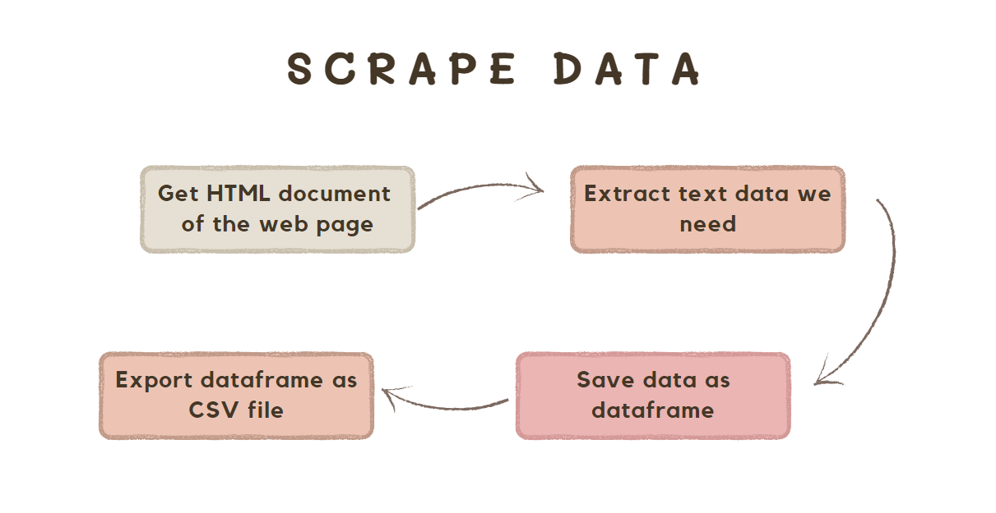
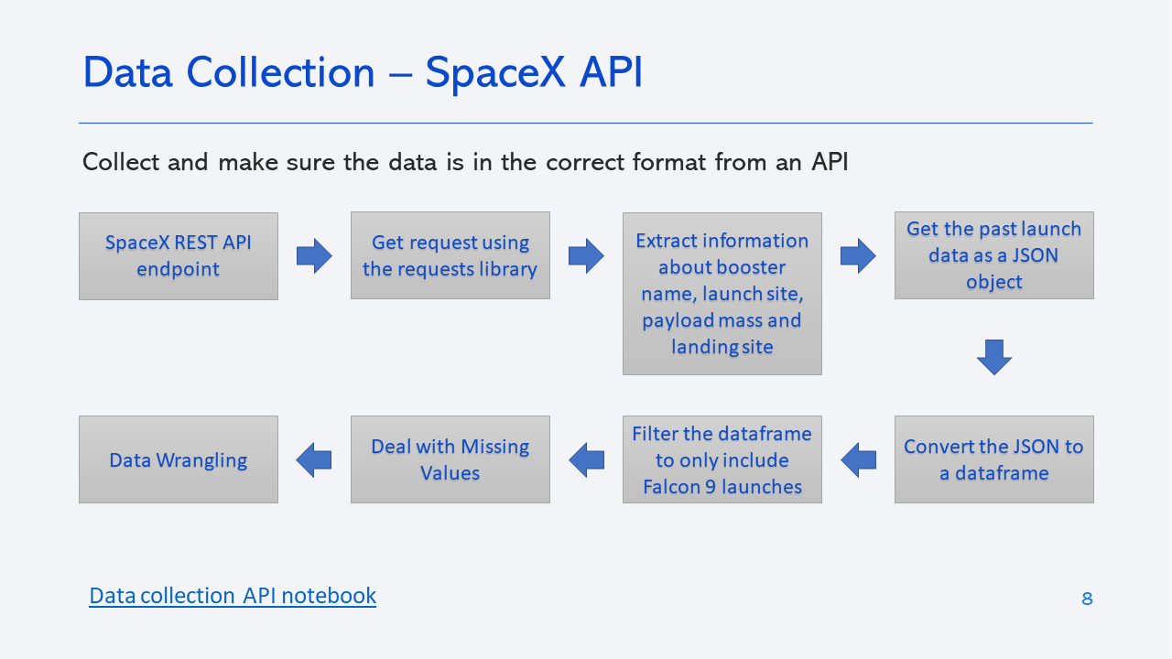
Data Collection
Web scrapping from Wikipedia
SpaceX API

Slide 8
Data Collection – SpaceX API
We used following URL:
https://cf-courses-data.s3.us.cloud-object-storage.appdomain.cloud/IBM-DS0321EN-SkillsNetwork/datasets/API_call_spacex_api.json
Pyhton, JSON, Pandas.
For more references look git repo:
https://github.com/Oleg-algebra/DataScienceCapstoneProject/blob/main/Module_1/Data-collection/jupyter-labs-spacex-data-collection-api.ipynb

Slide 9
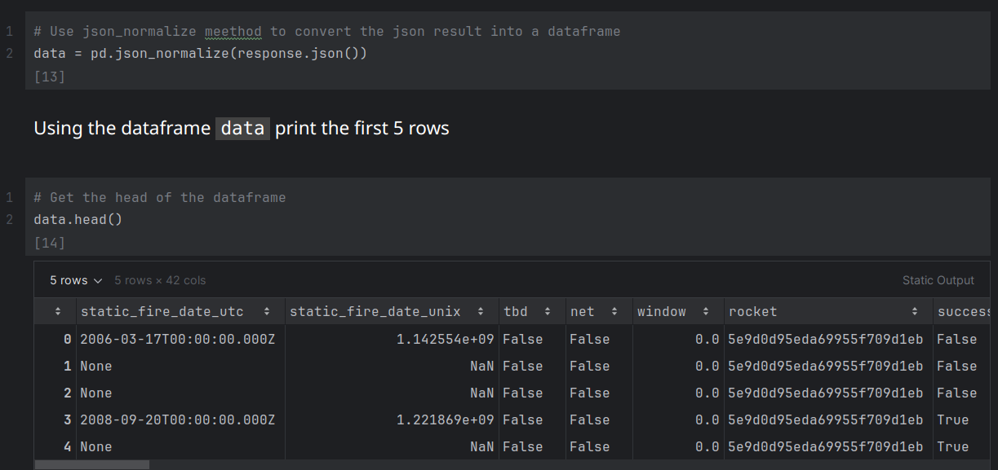
Result of API call

Slide 10
Data Collection - Scraping
Web Scrapping was performend on following web page:
https://en.wikipedia.org/wiki/List_of_Falcon_9_and_Falcon_Heavy_launches
Python, BeautifulSoap, HTML-parsing, Pandas.
For more references look git repo:
https://github.com/Oleg-algebra/DataScienceCapstoneProject/blob/main/Module_1/Data-collection/jupyter-labs-webscraping.ipynb
Place your flowchart of web scraping here

Slide 11
Data Wrangling
Data processing stages:
Determine what type of characteristics available, features and their data type.
Perform simple data analysis
What types of orbit are used
How many different launch sites we have
Calculate number of launches on different sites
Explore what type of outcomes are present and change them binary represantation(Success or Failure).
Export data frame to .csv file.
GitHub: https://github.com/Oleg-algebra/DataScienceCapstoneProject/blob/main/Module_1/Data-collection/labs-jupyter-spacex-Data%20wrangling.ipynb

Slide 12
EDA with Data Visualization
Main charts that were used:
Scatter plot – to determine relashionships between different features.
Line plot – to determine main trend of success rate through years
Bar plot – to visualize the relationship between success rate of each orbit type
GitHub:
https://github.com/Oleg-algebra/DataScienceCapstoneProject/blob/main/Module_2/edadataviz.ipynb

Slide 13
EDA with SQL
%sql select distinct "Launch_Site" from SPACEXTABLE
%sql select * from SPACEXTABLE where "Launch_Site" like "CCA%" limit 5
%sql select sum(PAYLOAD_MASS__KG_) from SPACEXTABLE where "Customer" = 'NASA (CRS)'
%sql select avg(PAYLOAD_MASS__KG_) from SPACEXTABLE where "Booster_Version" = 'F9 v1.1'
%sql select min("Date") from SPACEXTABLE where "Landing_Outcome" = 'Success (ground pad)'
%sql select "Booster_Version", PAYLOAD_MASS__KG_ from SPACEXTABLE where "Landing_Outcome" = 'Success (drone ship)' and PAYLOAD_MASS__KG_ > 4000 and PAYLOAD_MASS__KG_ < 6000
%sql select "Mission_Outcome", count(*) from SPACEXTABLE group by "Mission_Outcome"
%sql select "Booster_Version" from SPACEXTABLE where PAYLOAD_MASS__KG_ = (select max(PAYLOAD_MASS__KG_) from SPACEXTABLE)
%sql select (substr("Date",6,2)) as "Month", "Landing_outcome", "Booster_Version", "Launch_Site" from SPACEXTABLE where substr("Date",0,5) = '2015' and "Landing_outcome" = 'Failure (drone ship)'
%sql select "Landing_outcome", count(*) from SPACEXTABLE where "Date" between '2010-06-04' and '2017-03-20' group by "Landing_outcome" order by count(*) desc
GitHub: https://github.com/Oleg-algebra/DataScienceCapstoneProject/blob/main/Module_2/jupyter-labs-eda-sql-coursera_sqllite.ipynb

Slide 14
Build an Interactive Map with Folium
Marker, Circle, MarkerCLuster – were used to point launch sites and make it interactive.
Lines – were used to point nearest roads, railways, cities and show distance to them
Git: https://github.com/Oleg-algebra/DataScienceCapstoneProject/blob/main/Module_3/lab_jupyter_launch_site_location.ipynb

Slide 15
Build a Dashboard with Plotly Dash
Pie chart – to show success rate of landing
Scatter plot – to show relationship between PayloadMass and SuccessRate
DropDownOptions – to choose specific launch site to see success rate of given site
RangeSlider – to choose range of PayloadMass.
Git: https://github.com/Oleg-algebra/DataScienceCapstoneProject/blob/main/Module_3/spacex_dash_app.py

Slide 16
Predictive Analysis (Classification)
Steps:
Data loading
Features preprocesing, standartalization.
Train-test split
Models selection: LogisticRegression, SVM, TreeClassifier, KNN.
Models training.
Models evaluation
Git: https://github.com/Oleg-algebra/DataScienceCapstoneProject/blob/main/Module_4/SpaceX_Machine%20Learning%20Prediction_Part_5.ipynb

Slide 17
Results
Exploratory data analysis results
VAFB SLC 4E – doesn’t have rockets with payload mass greater than 10000kg.
Increasing trend of success rate landing from 2010 to 2020.
Predictive analysis results
All models have accuracy on testing set greater than 83%
The best results was show by TreeClassifier and KNN models with 87% and 86% of accuracy respectively.

Slide 18
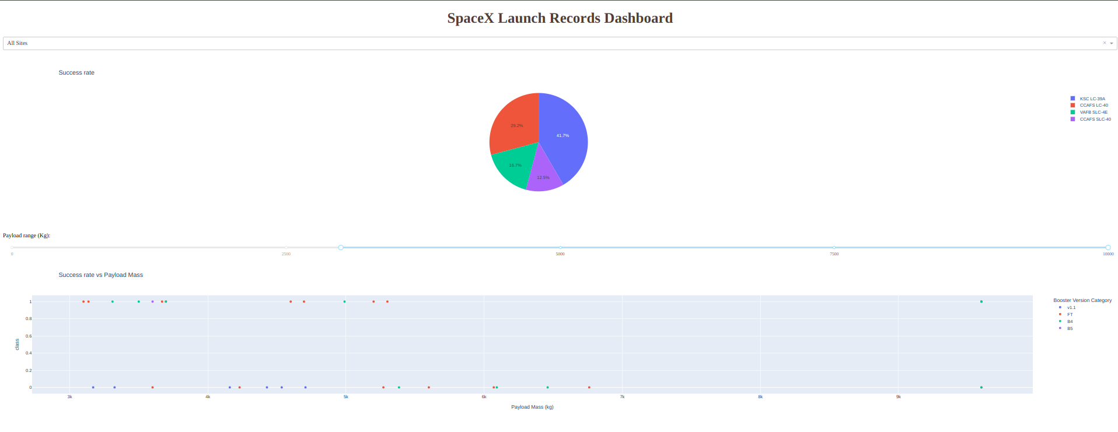

Slide 19

Section 2

Slide 20
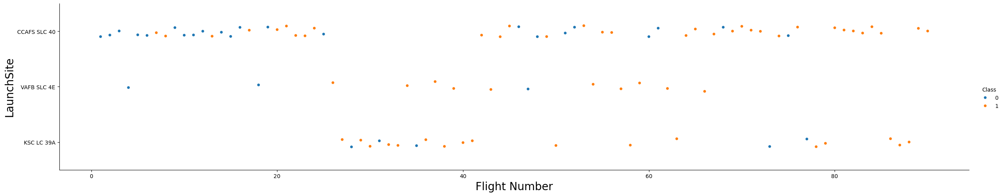
Flight Number vs. Launch Site
Biggest numbers of landings was on launch site CCAFS SLC 40.
The least amount of landings – VAFB SLC 4E.
KSC LC 39A wasn’t used for the first landings. CCAFS SLC 40 is used unifomly through all period of time.
For last 40 flight number CCAFS SLC 40 has hight success rate of landing

Slide 21
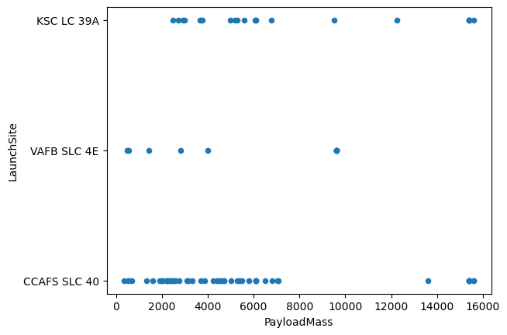
Payload vs. Launch Site
VAFB SLC 4E doesn’t have payload mass greater than 10000
CCAFS SLC 40 commonly used for payloads smaller than 8000.
KSC LC 39A has different types of payload record.

Slide 22
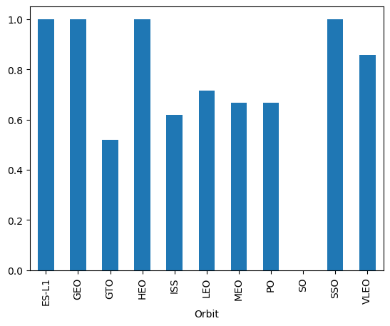
Success Rate vs. Orbit Type
Orbits ES-L1, GEO, HEO, SSO have the highest success rate.
SO – has the lowest success rate.
Rest of orbits have average success rate .

Slide 23
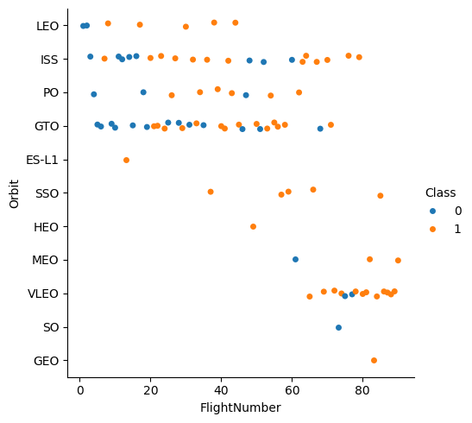
Flight Number vs. Orbit Type
Most commonly used orbits are LEO, ISS and GTO.
VLEO has increasing trend of usage for last 40 flight numbers.
ES-L1, HEO, GEO, SO have only one record of flight. It explains some results from previous slide.

Slide 24
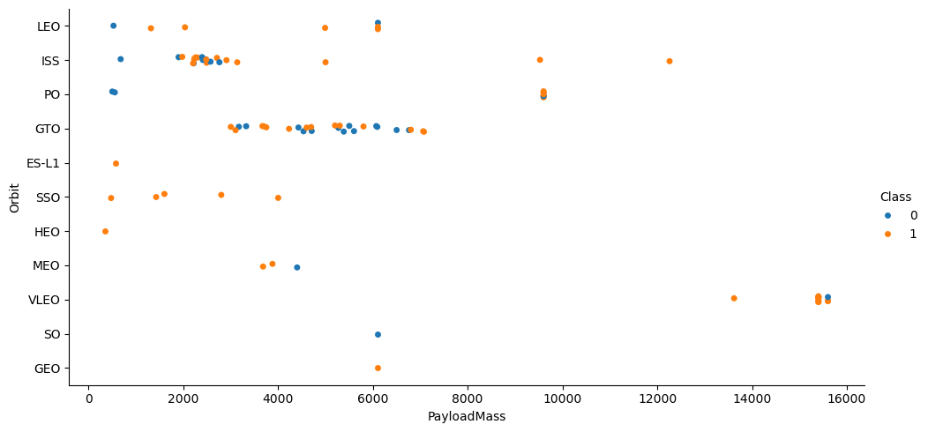
Payload vs. Orbit Type

Slide 25
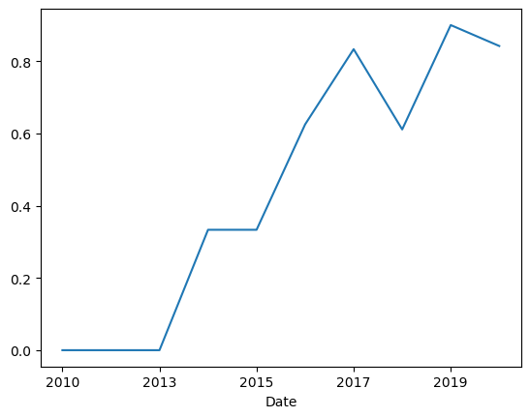
Launch Success Yearly Trend
From 2010 to 2013 we can see 0 success rate.
From 2013 to 2020 we can see increasing trend of average success rate of landing.

Slide 26
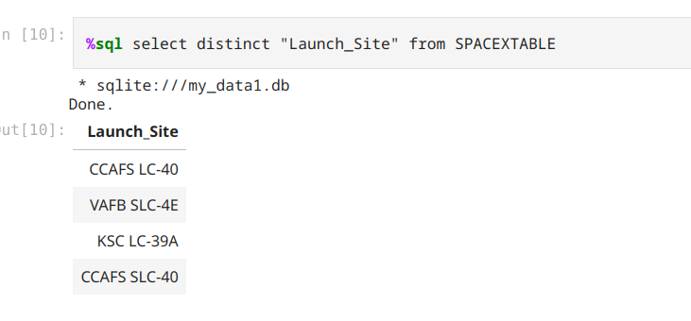
All Launch Site Names
Using sql magic we can that our data base have four distinct launch sites where rockets are landing.

Slide 27
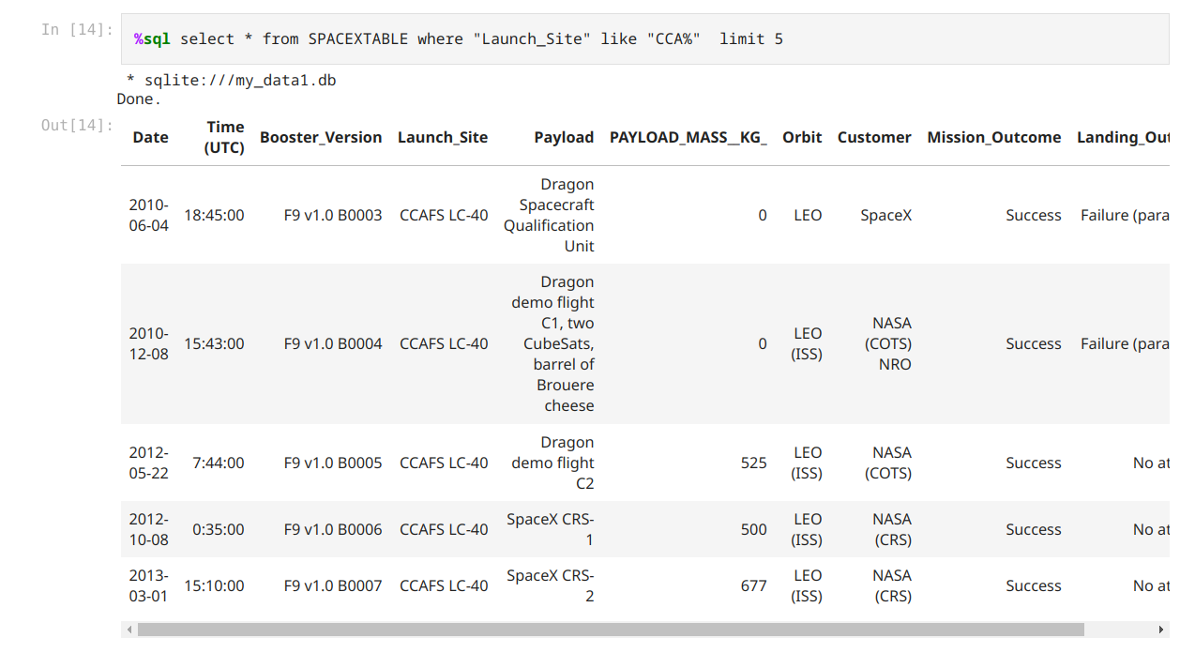
Launch Site Names Begin with 'CCA'
We have that first landing attempt was in 2010 and ended with failure.
From the first five records we see that there was 2 flights per year on average.

Slide 28
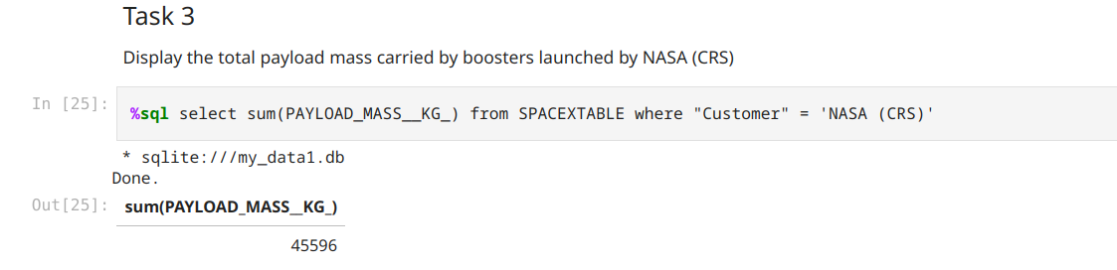
Total Payload Mass
From 2010 to 2020 total PayLoad is more than 45 tons.

Slide 29
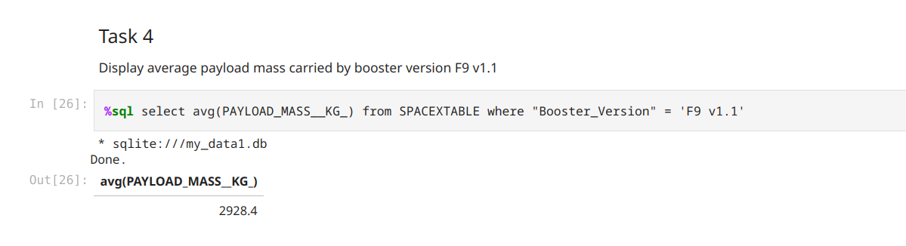
Average Payload Mass by F9 v1.1
Calculate the average payload mass carried by booster version F9 v1.1
Present your query result with a short explanation here

Slide 30
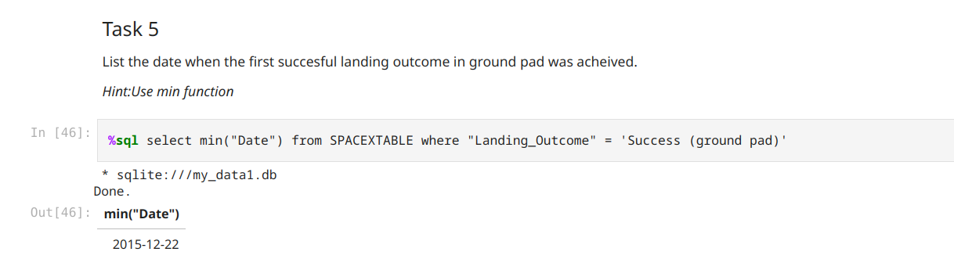
First Successful Ground Landing Date
First successful landing occurred only after 5 years after first flight.

Slide 31
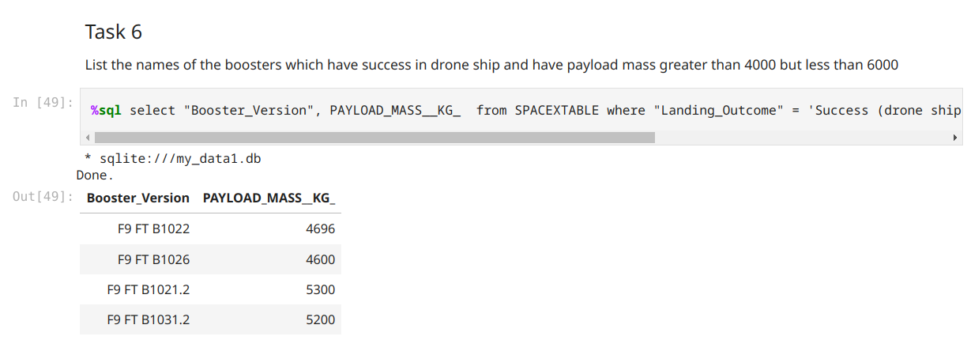
Successful Drone Ship Landing with Payload between 4000 and 6000
There are only 4 records and all of them belongs to booster F9 type.

Slide 32
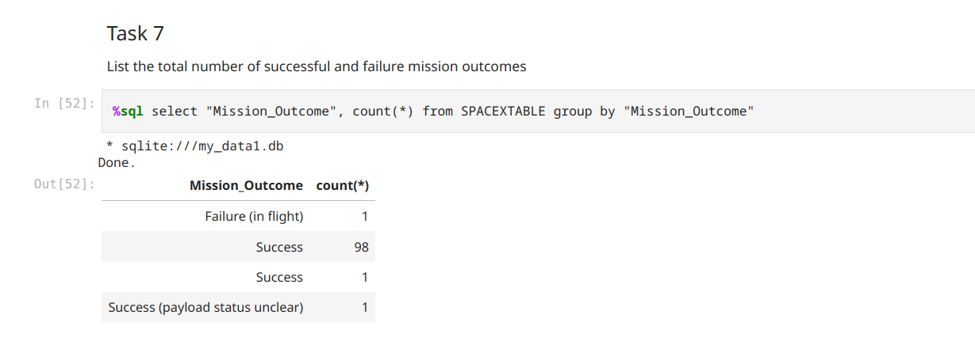
Total Number of Successful and Failure Mission Outcomes
Calculate the total number of successful and failure mission outcomes
Present your query result with a short explanation here

Slide 33
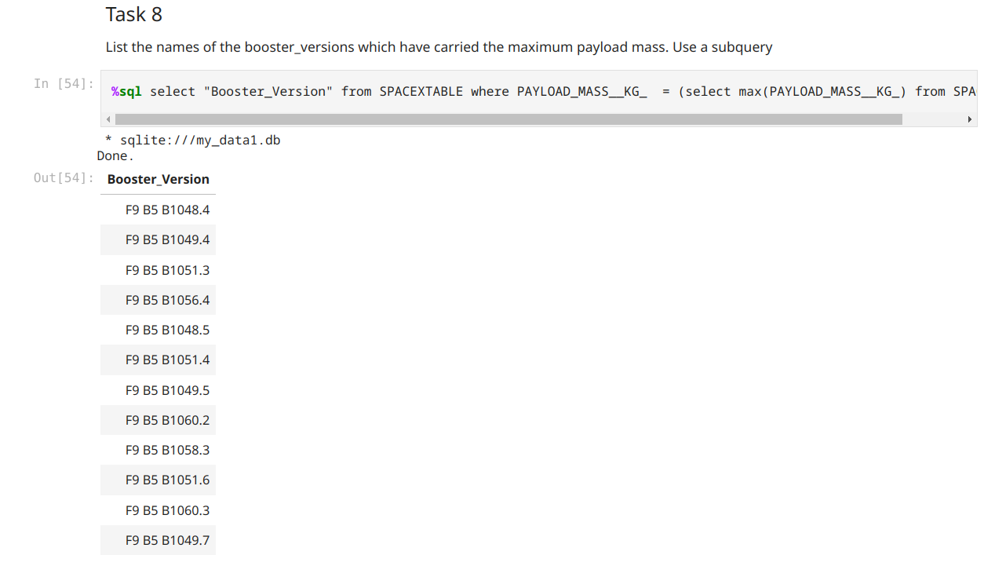
Boosters Carried Maximum Payload
All boosters with max PayloadMass are boosters F9 B5 B..

Slide 34
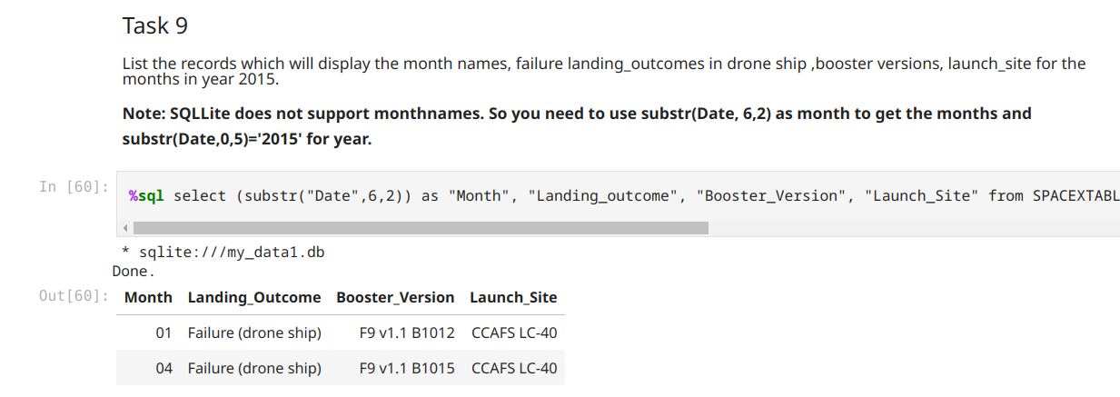
2015 Launch Records
There are two cases and both of them are have booster version F9 v1.1 and occurred on CCAFS LC-40 launch site.

Slide 35
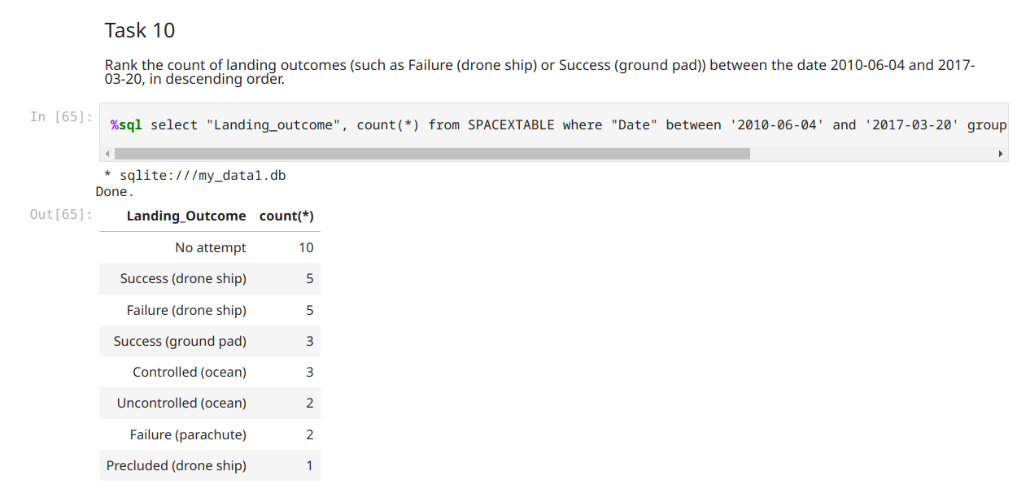
Rank Landing Outcomes Between 2010-06-04 and 2017-03-20
The most frequent result is no attempt for landing.
The most frequent success landing is performed on drone ship. Also such type of landing has a biggest count of failures.

Slide 36

Section 3

Slide 37
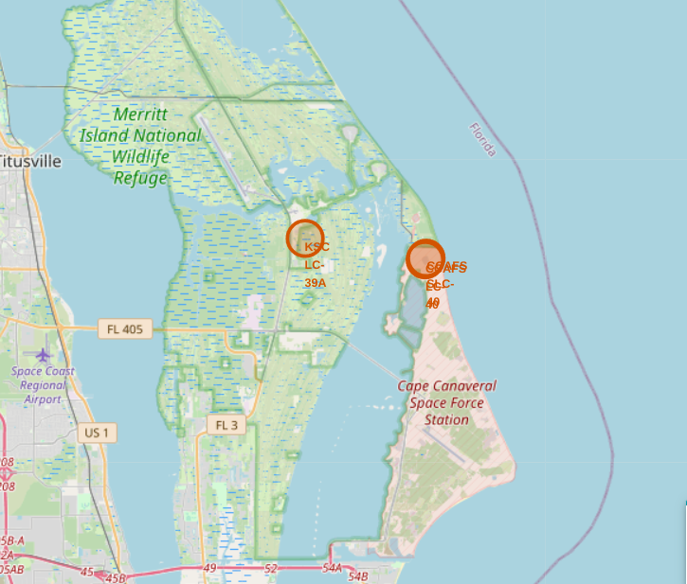
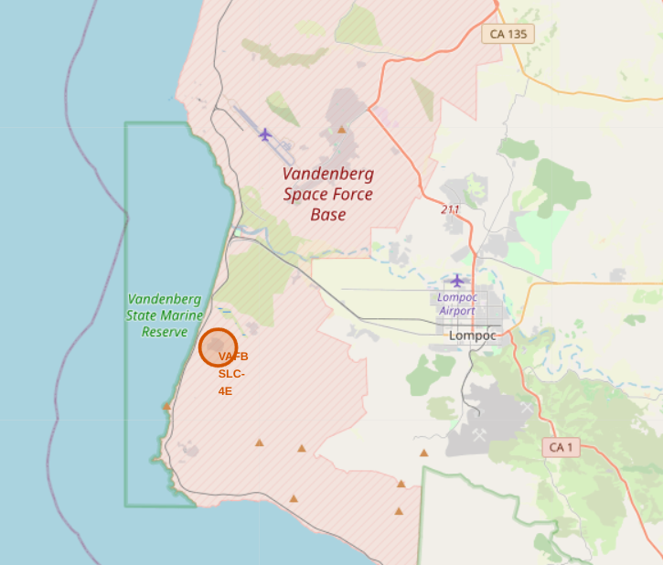
Map of launching sites
According to generated map we have two main regions.
First region located in the east part of America and has three launching sites.
Second region located on the west part of continent and has only one launching site.

Slide 38
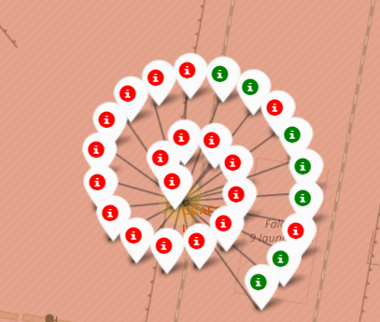
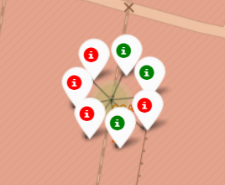
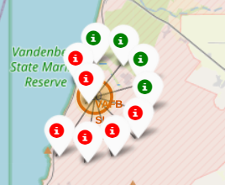
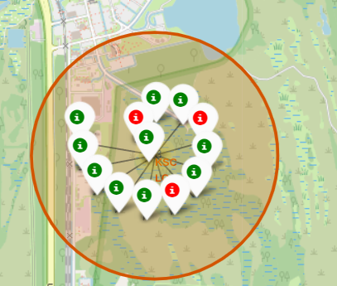
Map of landing outcomes
From screenshots we can see that east region has the biggest amount of landings attempts, see upper most pictures and second picture in the second row.
Also picture in first row and first column shows that CCAFS SLC-40 has the biggest count of landings and most of them are failures(red color).
On the contrary KSC LC-39A has the biggest amount of successful landings.

Slide 39
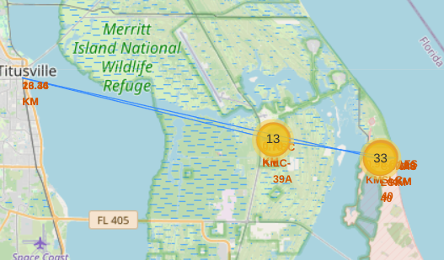
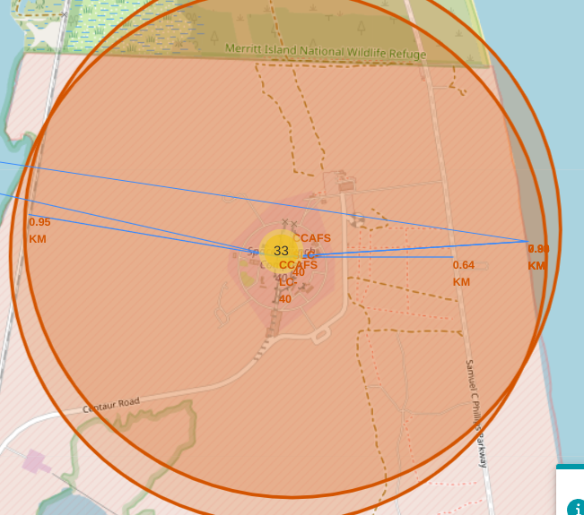
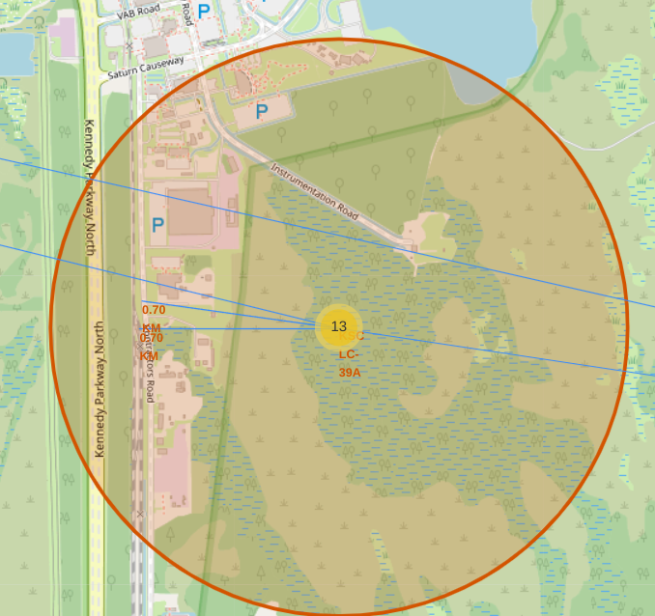
Launch sites location observation
All launch sites have railways, roads and coastlines near them, but located far from cities.

Slide 40

Section 4

Slide 41
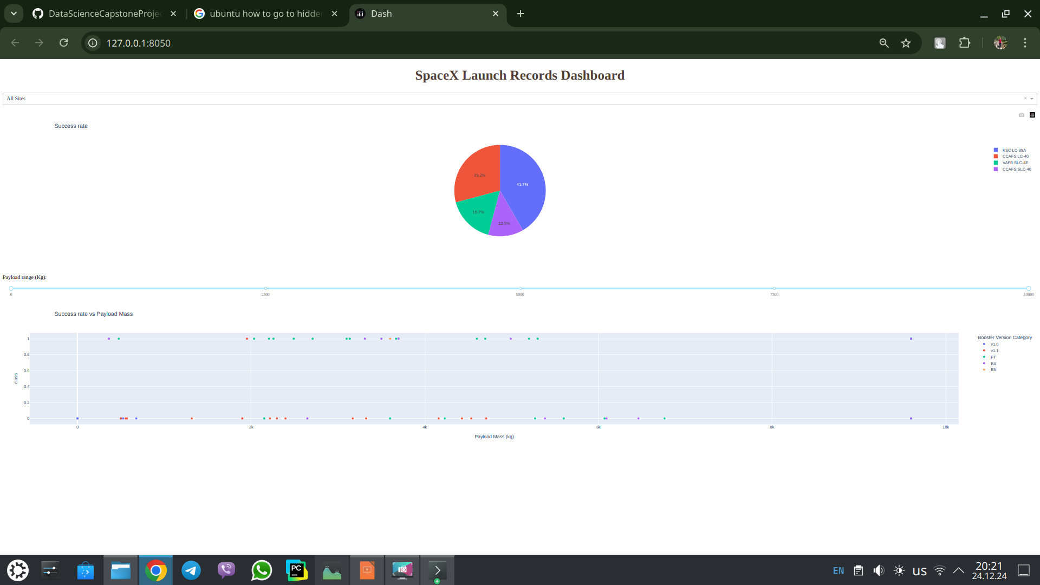
All sites success rate
There we have 4 main elements:
DropDownMenu to choose launching site
PieChart
RangeSlider to choose range of Payload Mass(kg)
Scatter plot “Payload Mass vs Success rate”.
From piechart we can see that KSC LC-39A has the highest success rate.

Slide 42
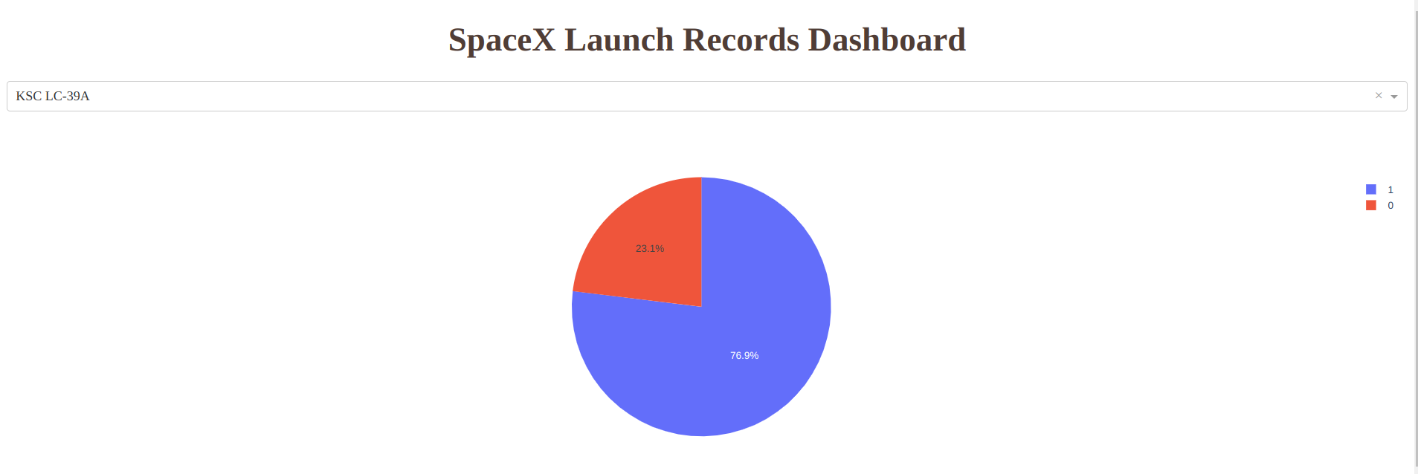
KSC LC-39A success rate
From pie chart we can see that success rate on that site is greater than 75%

Slide 43
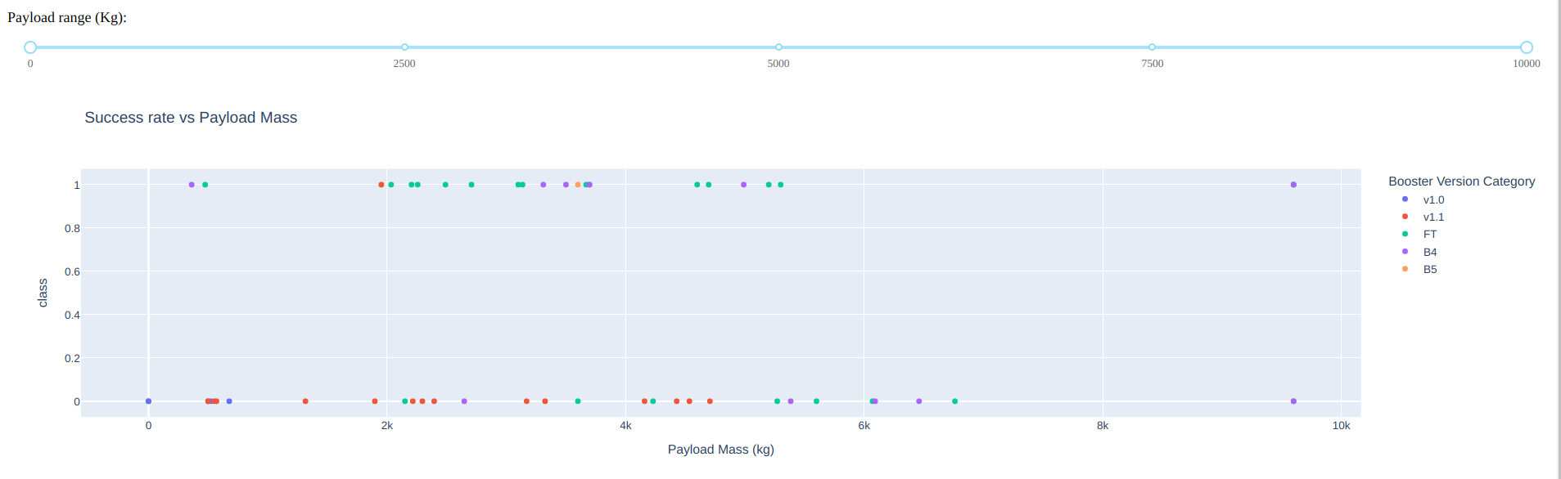
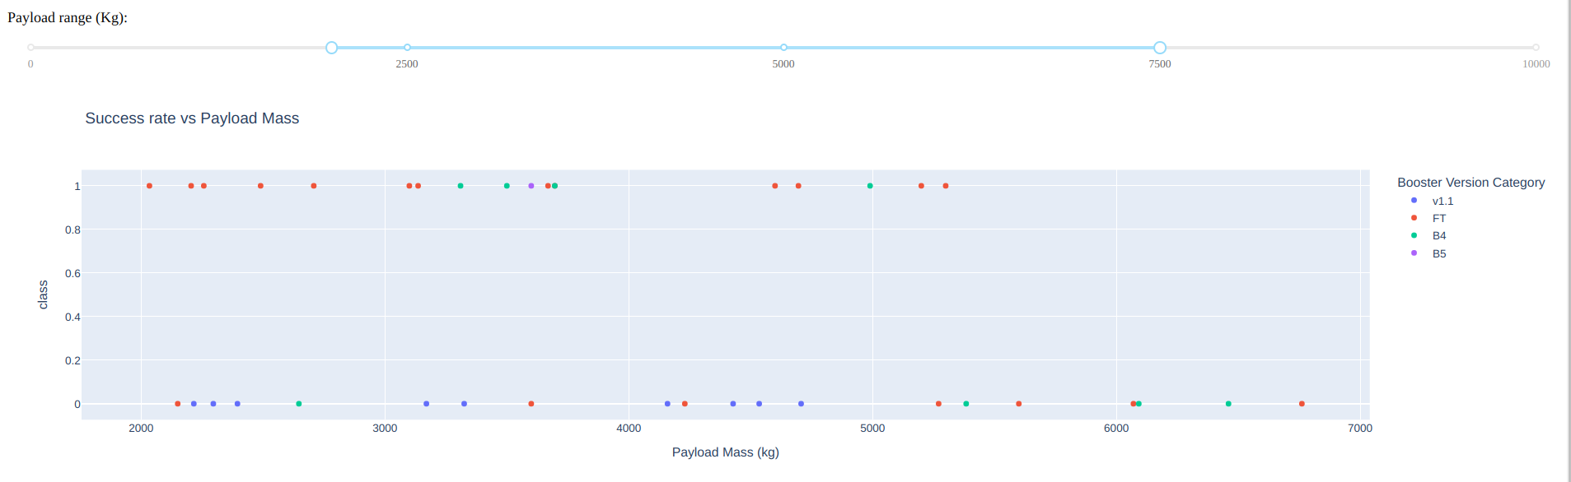
PayloadMass vs Success rate

Slide 44
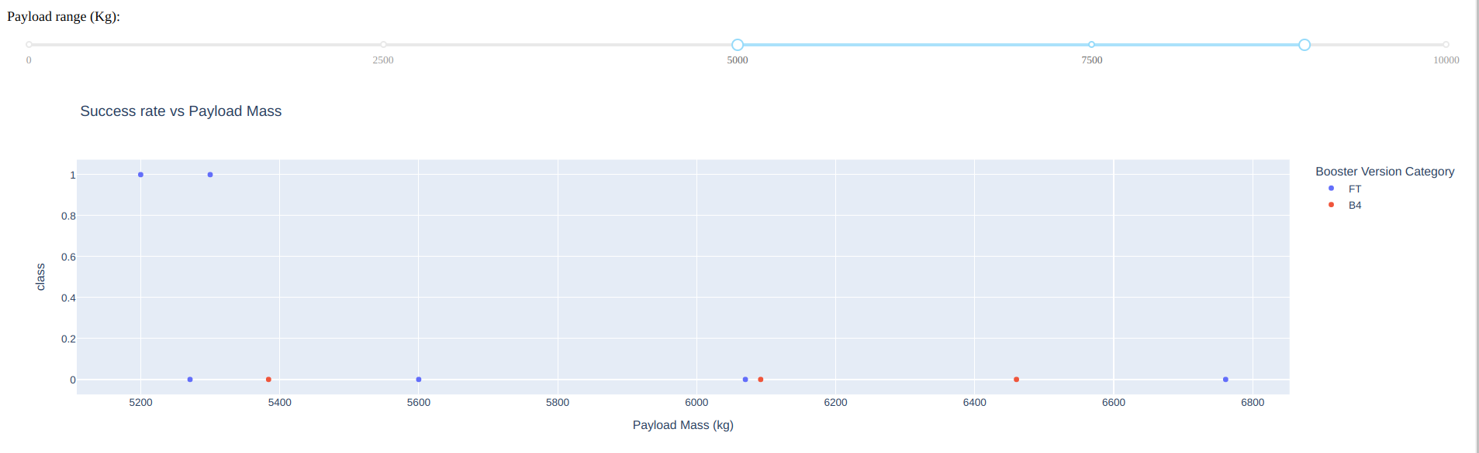
From screenshots we can see that payload range from 5000 to 7000 have the lowest success rate
The biggest success rate can be if payload will be in range between 2000 and 5500
Booster version category FT has the highest succes rate across differrent payload masses

Slide 45

Section 5

Slide 46
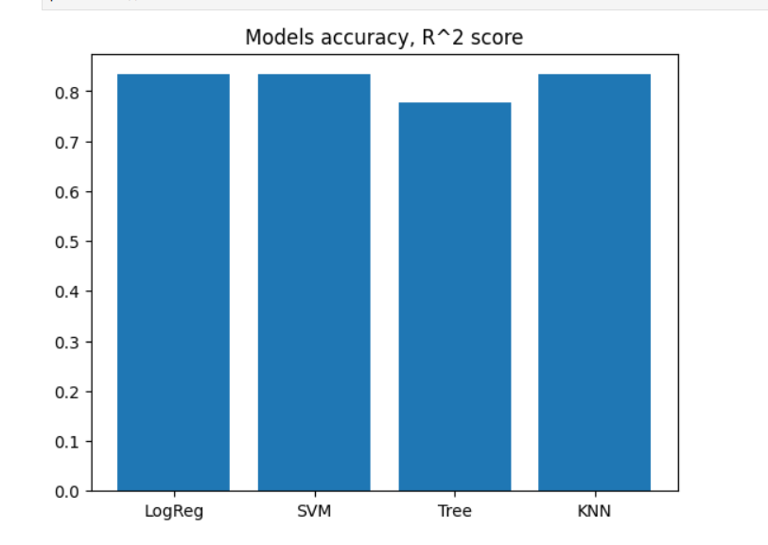
Classification Accuracy
From a bar chart we can see that KNN and SVM have the highest R^2 score.
On the contrary TreeClassifier has the lowest result.

Slide 47
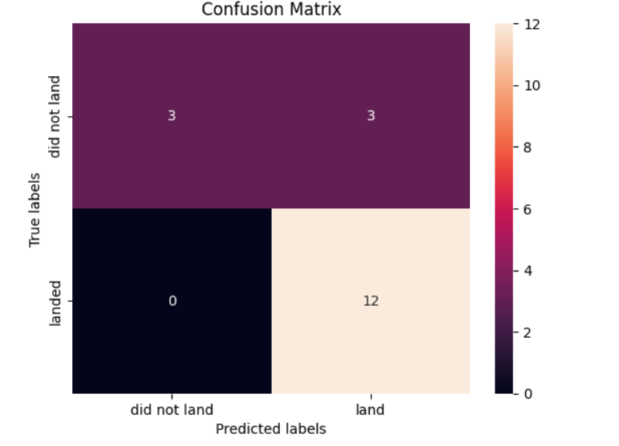
Confusion Matrix
On the screenshot on the right confusion matrix of KNN model.
We can see that model differentiate between classes.
There some problems with False positive error and need some improvement.
Such model perfectly handle successful landings.

Slide 48
Conclusions
VAFB SLC 4E – doesn’t have rockets with payload mass greater than 10000kg.
Increasing trend of success rate landing from 2010 to 2020.
All boosters with max PayloadMass are boosters F9 B5 B…
CCAFS SLC-40 has the biggest count of landings and most of them are failures.
The biggest success rate can be if payload will be in range between 2000 and 5500.
KNN and SVM have the highest R^2 score.

Slide 49


